Slide 1
Retirement Presentation
2022

Slide 2
Retirement Readiness
Planning Tools
The terms of the plan, program or Company policy documents govern the benefits and privileges highlighted in this presentation. If there is a conflict between this presentation and the plan program or Company policy document will govern the actual benefit or privilege.

Slide 3
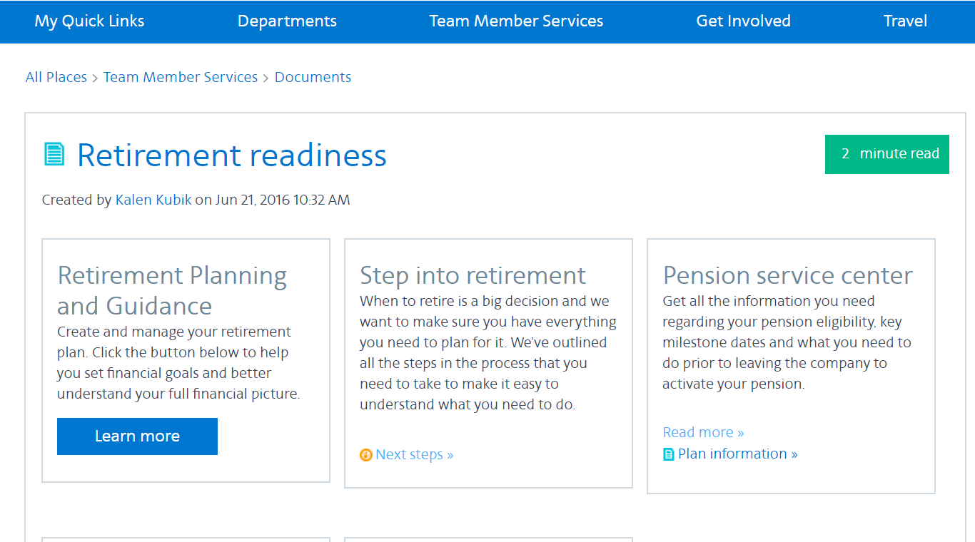
Retirement readiness
Notes:
After answering the questions, the participant will receive an Retirement Analysis:
This is a one-page experience where participants are able to model various scenarios.
They have the option to display their results based on market performance and hypothetical income vs. assets (we default to the 90%, but they can easily toggle to see the 755 of 50%).
The retirement score is a single number that provides an approximate percentage of income a participant is estimated to have—assuming an underperforming market.
Results are displayed in numbers and pictures so that they can see what they may have, what they may need, and their shortfall.
At the bottom, a participant can model changes via the different tabs (savings rate, asset mix, retirement time and expenses). And as they model changes, they can easily see the results in the numbers and charts above.
From the results screen, participants can view their accounts and add other accounts or income sources to the planning process.

Slide 4
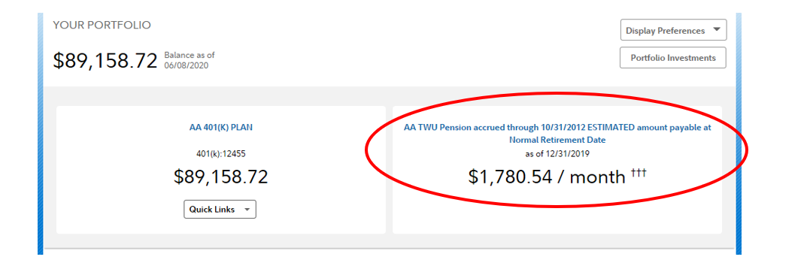
Fidelity NetBenefits
Notes:
After answering the questions, the participant will receive an Retirement Analysis:
This is a one-page experience where participants are able to model various scenarios.
They have the option to display their results based on market performance and hypothetical income vs. assets (we default to the 90%, but they can easily toggle to see the 755 of 50%).
The retirement score is a single number that provides an approximate percentage of income a participant is estimated to have—assuming an underperforming market.
Results are displayed in numbers and pictures so that they can see what they may have, what they may need, and their shortfall.
At the bottom, a participant can model changes via the different tabs (savings rate, asset mix, retirement time and expenses). And as they model changes, they can easily see the results in the numbers and charts above.
From the results screen, participants can view their accounts and add other accounts or income sources to the planning process.

Slide 5
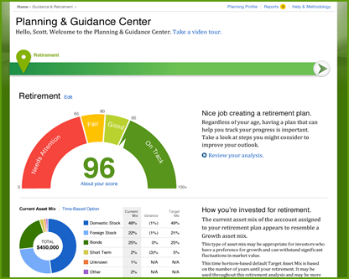
Planning & Guidance Center on NetBenefits®
A personalized, online planning experience to help you set goals and better understand your full financial picture
Access the Planning & Guidance Center on NetBenefits from the Planning link on the homepage
From there, you can create a plan for retirement, college, or a personal savings goal – or get help with your investment strategy
CREATE A GOAL (first-time visitor)
PLANNING & GUIDANCE CENTER LANDING PAGE (return user)
Notes:
Access the Planning & Guidance Center on NetBenefits® via the Planning link on the home page.
If the participant is a first time user, they will be given a choice of what they want to do—create a plan for retirement, college, or a personal savings goal – or get help with their investment strategy. If they select the retirement option, they will need to answer just a few questions to get started.
A return user will see the Retirement Score to help them understand how they are doing. The score will only be seen by return users who are not retired (retirees will see a different view with their information and estimates).

Slide 6
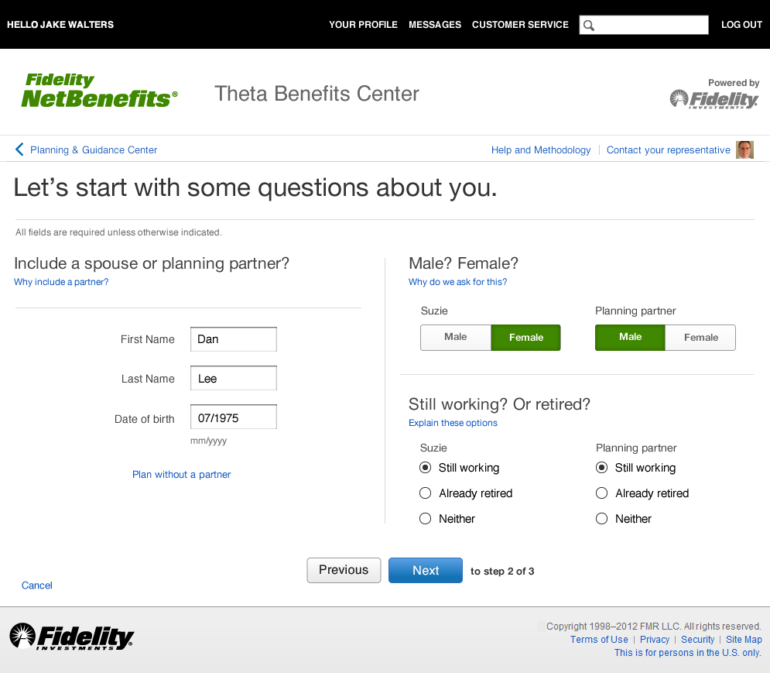
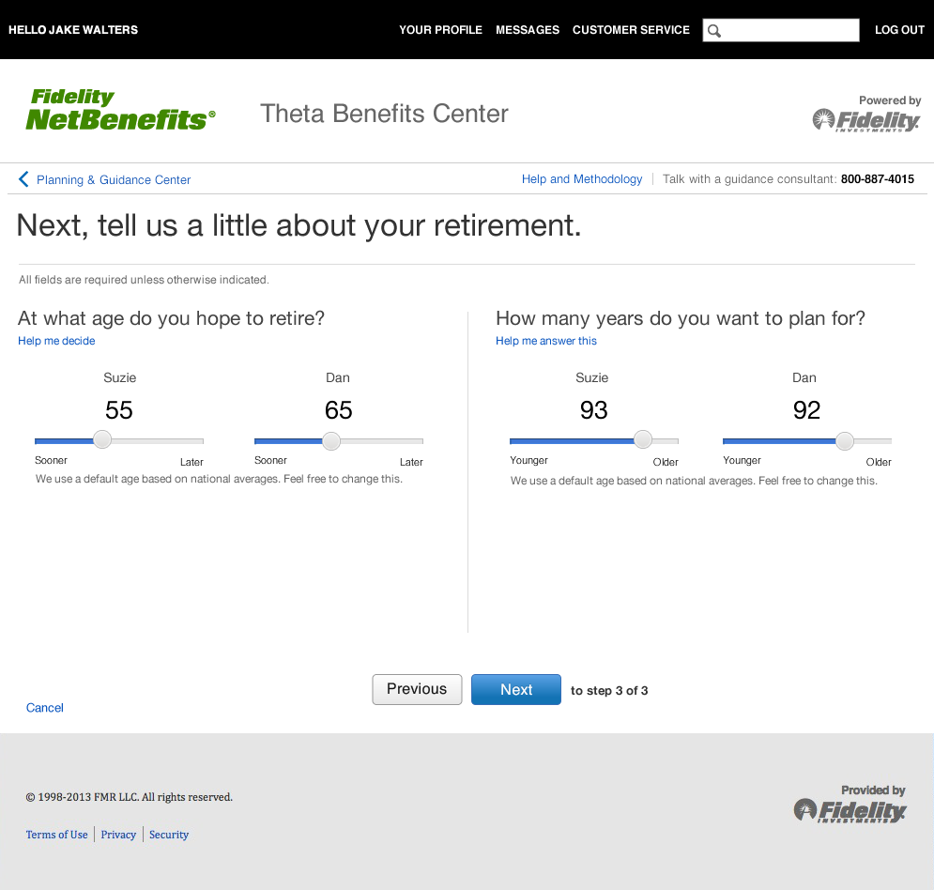
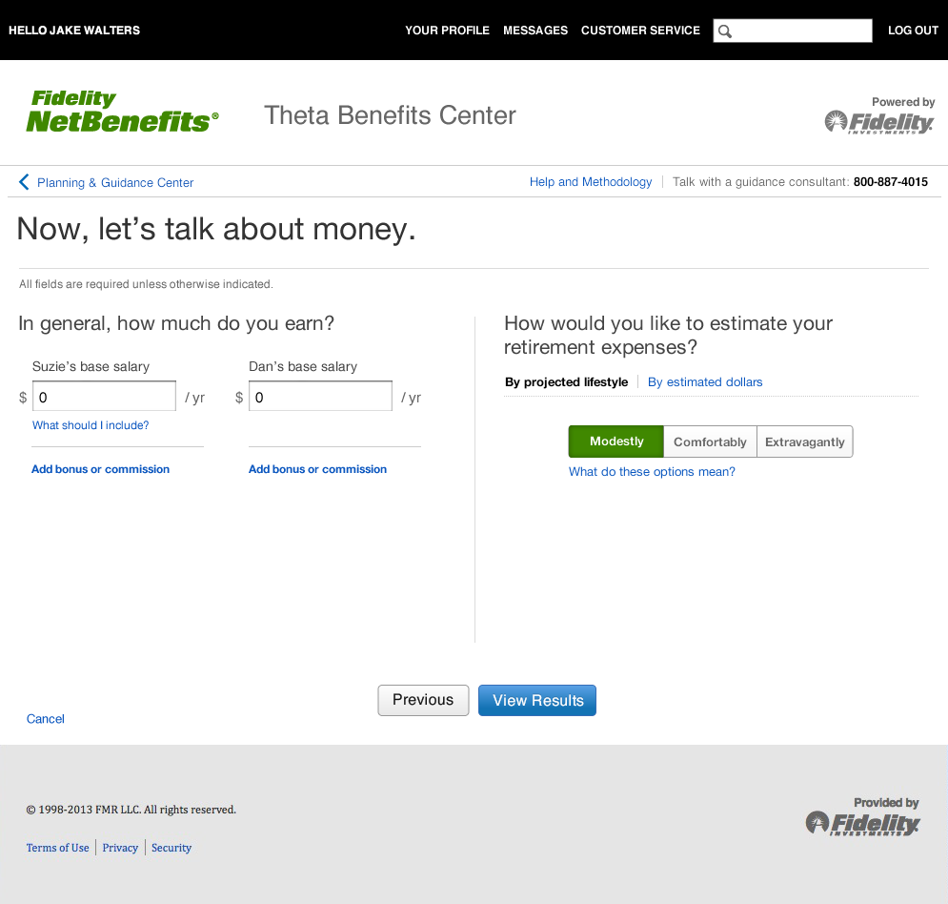
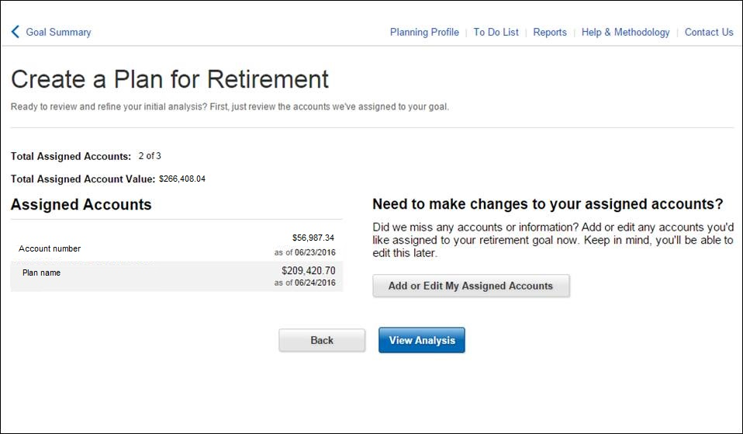
Add a retirement goal
Create a retirement plan that’s based on your personal situation.
By answering just a few questions, you’ll be able to:
Estimate how much income you may have—or need—in retirement
Receive next steps to consider to help you get or stay on track
Create a retirement plan in minutes
PERSONAL INFORMATION
RETIREMENT GOALS
INCOME AND EXPENSES
CONFIRM ACCOUNTS
Are you including a spouse or planning partner?
Are you still employed or retired?
At what age do you plan to retire?
How many years do you want to plan for?
What are your current earnings?
How do you want to estimate retirement expenses—by projected lifestyle or dollars?
Review and confirm the accounts that will be included in your plan
Notes:
Once inside the Planning & Guidance Center, a participant can create a retirement goal. In order to get started, they must answer a few questions. Questions are targeted by life stage—early accumulator, late accumulator, transition, and retiree.
Question #1: Personal information
The new model is to ask the participant as few questions as possible, give them an answer, and then allow them to refine that answer.
If we already have all the data needed, the participant will not be asked any questions.
If they are an early accumulator, they will only be asked three questions: planning partner, gender, and salary.
Question #2: Retirement goals
Here we ask about the age in which they plan to retire (the retirement default is set to when they would receive their full Social Security benefit based on their date of birth) and when they might expire. The experience then uses actuarial tables that show when 25% of their gender born in that year would still be alive.
They can easily just slide the toggle bar.
There is logic within that won’t let them expire before they retire, and not retire before their current age.
Question #3: Income and expenses
If we have the salary, we will prefill it. If they are planning with a spouse, they will need to add their salary.
The right side is an easy way for them to tell us how much they might spend in retirement. We put it into words to make it easier for them to complete.
If they know they will spend a set amount, say $3K per month, they can put that number in. The participant also has the opportunity to get more detailed using a budget worksheet (optional).
We will also show a fourth screen that illustrates for the participant what accounts are included in their plan.
The engine will then run Monte Carlo simulations with numerous projections and calculate their results.

Slide 7
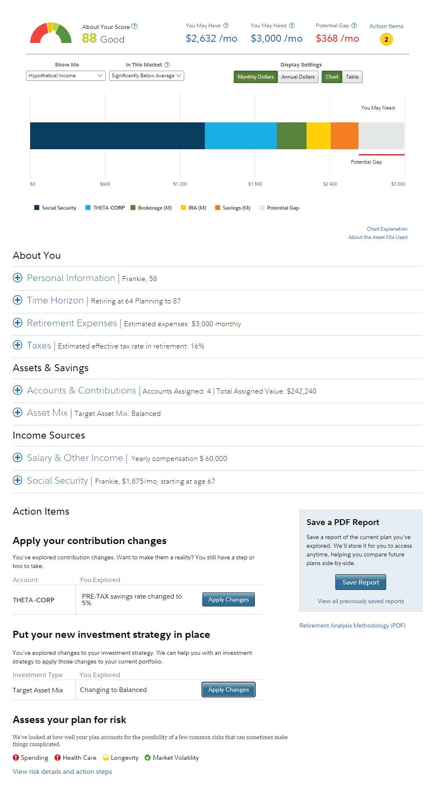
Get your Retirement Analysis
Model various scenarios and see the potential effect any changes may have on your retirement savings outlook.
1
Retirement Score
Represents the percentage of your average estimated retirement expenses your plan could cover, assuming an underperforming market.
1
2
2
Display preferences*
View assumptions for a significantly underperforming market (90% confidence), a below-average market (75% confidence), and an average market (50% confidence).
See results using monthly or annual dollars via a chart or table.
3
3
Results chart
Illustrates what you may have, how much you may need, and the potential gap (other chart views are available).
4
4
About you
Update important information such as age, time horizon to retirement, anticipated retirement expenses, and tax rate in retirement.
5
5
Assets & Savings
Update or add accounts (including non-Fidelity accounts), and how much you contribute to them.
Review or adjust your asset mix.
6
6
Income sources
Enter any income sources and Social Security amounts.
Notes:
After answering the questions, the participant will receive an Retirement Analysis:
This is a one-page experience where participants are able to model various scenarios.
They have the option to display their results based on market performance and hypothetical income vs. assets (we default to the 90%, but they can easily toggle to see the 755 of 50%).
The retirement score is a single number that provides an approximate percentage of income a participant is estimated to have—assuming an underperforming market.
Results are displayed in numbers and pictures so that they can see what they may have, what they may need, and their shortfall.
At the bottom, a participant can model changes via the different tabs (savings rate, asset mix, retirement time and expenses). And as they model changes, they can easily see the results in the numbers and charts above.
From the results screen, participants can view their accounts and add other accounts or income sources to the planning process.

Slide 8
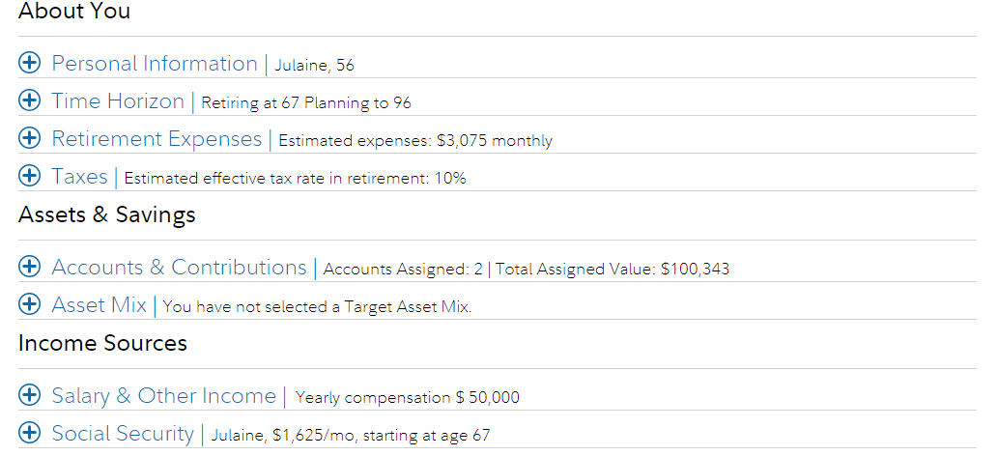
Income Sources - Pension
Notes:
After answering the questions, the participant will receive an Retirement Analysis:
This is a one-page experience where participants are able to model various scenarios.
They have the option to display their results based on market performance and hypothetical income vs. assets (we default to the 90%, but they can easily toggle to see the 755 of 50%).
The retirement score is a single number that provides an approximate percentage of income a participant is estimated to have—assuming an underperforming market.
Results are displayed in numbers and pictures so that they can see what they may have, what they may need, and their shortfall.
At the bottom, a participant can model changes via the different tabs (savings rate, asset mix, retirement time and expenses). And as they model changes, they can easily see the results in the numbers and charts above.
From the results screen, participants can view their accounts and add other accounts or income sources to the planning process.

Slide 9
Get actionable next steps
Take action or download your report for review
1
Implement changes
Outlines changes that you may need to make to put your plan into action.
Automatically brings you where you need to go to take action and make changes.
2
1
2
Download your report
Provides a snapshot and summarizes inputs, results, and potential action steps; reports are stored in the Reports section.
3
Risk assessment
Scores participants who are 10 or fewer years from retirement against key risks of retirement.
3
Notes:
Within the Action Items section, the participant (or, the Fidelity phone representative) can create a report, and the report will automatically be stored in the Report Center; Fidelity phone representatives also have the option to send the report to a participant via print, email, or US mail.
This area lists the changes that the participant could take to implement their plan. When they select the “Make Change” button, they will be taken to the part of NetBenefits where they can make those changes (they are also shown a summary of any changes made).
For participants who are 10 or fewer years from retirement, this page tab will score them against key retirement risks.

Slide 10
Retirement Resources
The terms of the plan, program or Company policy documents govern the benefits and privileges highlighted in this presentation. If there is a conflict between this presentation and the plan program or Company policy document will govern the actual benefit or privilege.

Slide 11
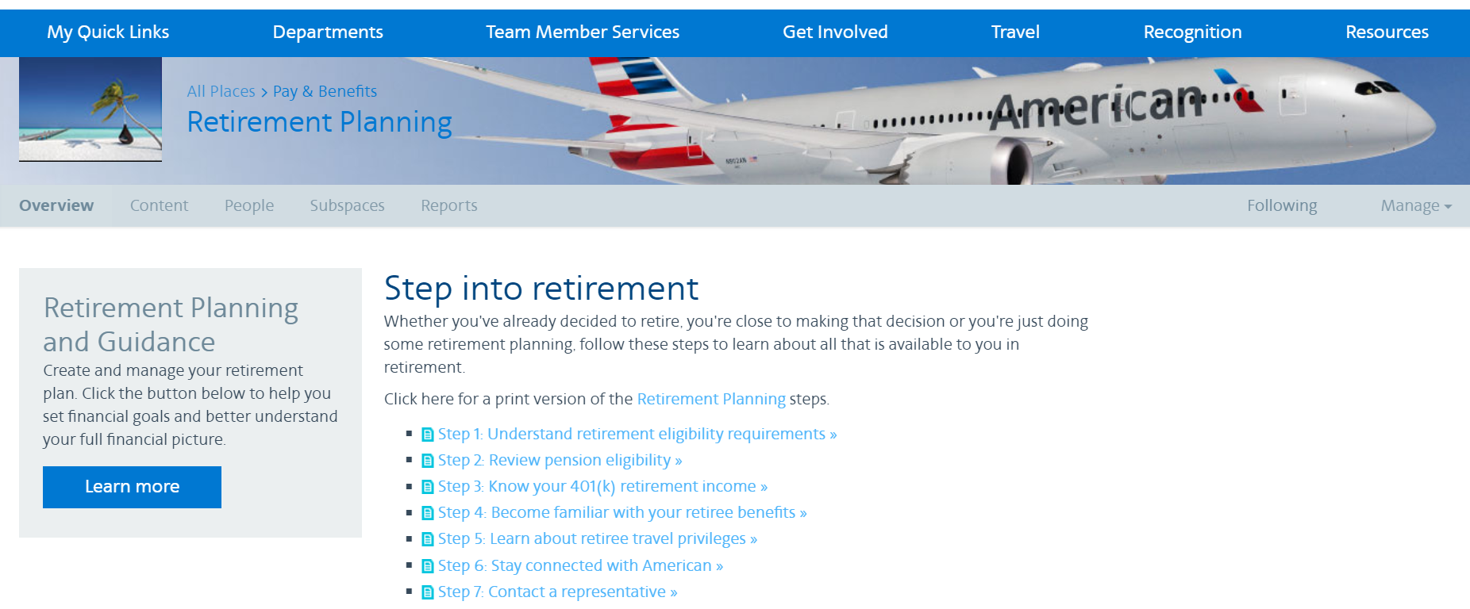
Jetnet Retirement Planning
Retirement Planning
Access from Jetnet’s Team Member Services tab - click on Leaving the Company- then click on next steps in the Retirement Planning box
The Retirement Planning walks you through important steps:
Retirement Eligibility
Pension
401(k)
Benefits
Travel
The terms of the plan, program or Company policy documents govern the benefits and privileges highlighted in this presentation. If there is a conflict between this presentation and the plan program or Company policy document will govern the actual benefit or privilege.

Slide 12
65 Point Plan Retirement Eligibility
The 65 Point Plan calculated as at least 10 years of company service, and your age and years of service must equal 65 or greater at the time of separation
Age + Company Service (min of 10) = 65 or greater
Benefits and Privileges include:
Retiree Travel
Retirees.aa.com access to book travel and general information
Payout of accrued sick time, if applicable
Retirement Gift
Retirement ID
Cobra Coverage
Retiree Medical Access, only if age 55-65
The terms of the plan, program or Company policy documents govern the benefits and privileges highlighted in this presentation. If there is a conflict between this presentation and the plan program or Company policy document will govern the actual benefit or privilege.

Slide 13
LAA Pension Eligibility
Eligibility
Your eligibility to begin receiving your pension benefit is based on your age and Retirement Eligibility Service (RES). You must separate from the Company to commence pension.
15 + years of RES may commence as early as age 55
14 - 10 years of RES may commence as early as age 60
Less than 10 years of RES may commence at age 65
Contact
HR Services - Pension Service Center / 1-866-470-0847
The terms of the plan, program or Company policy documents govern the benefits and privileges highlighted in this presentation. If there is a conflict between this presentation and the plan program or Company policy document will govern the actual benefit or privilege.

Slide 14
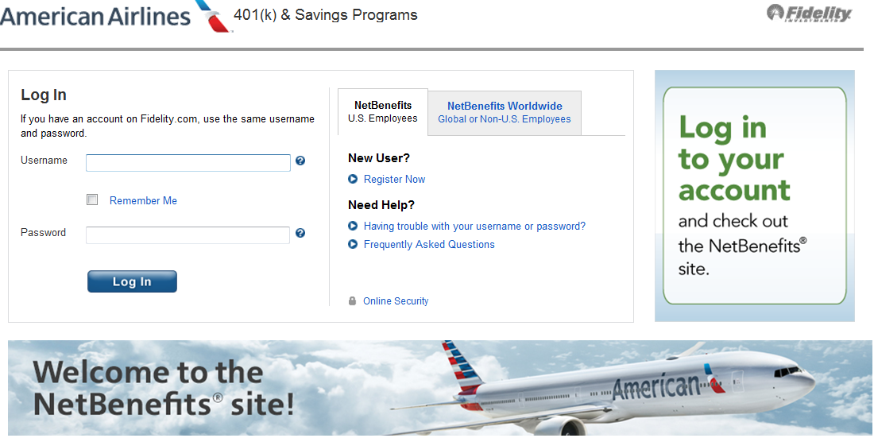
401(k) Account
Distributions
You can take distributions from your 401(k) account when you retire, based on IRS regulations
Validation period: Please note that your 401(k) account will be frozen for 30 days after your retirement date before you can begin distributions
Contributions
Consider making “catch up contributions”
before you retire
Contact
Fidelity Investments
www.netbenefits.com/aa
(800)354-3412
The terms of the plan, program or Company policy documents govern the benefits and privileges highlighted in this presentation. If there is a conflict between this presentation and the plan program or Company policy document will govern the actual benefit or privilege.

Slide 15
Benefits into Retirement
Cobra
Medical, Dental, Vision and FSA’s
Solicited upon retirement from the Benefits Service Center 1-888-860-6178
Retiree Standard Medical (only if ages 55-65)
$1,826 per month per person (2022 cost)
Solicited upon retirement from the Benefits Service Center (can purchase after COBRA is exhausted)
Via Benefits
Private Insurance marketplace
1-844-287-9947 Pre-65 or 1-844-686-0483 Post-65
Retiree Dental
You may purchase directly with MetLife (after COBRA is exhausted)
The terms of the plan, program or Company policy documents govern the benefits and privileges highlighted in this presentation. If there is a conflict between this presentation and the plan program or Company policy document will govern the actual benefit or privilege.

Slide 16
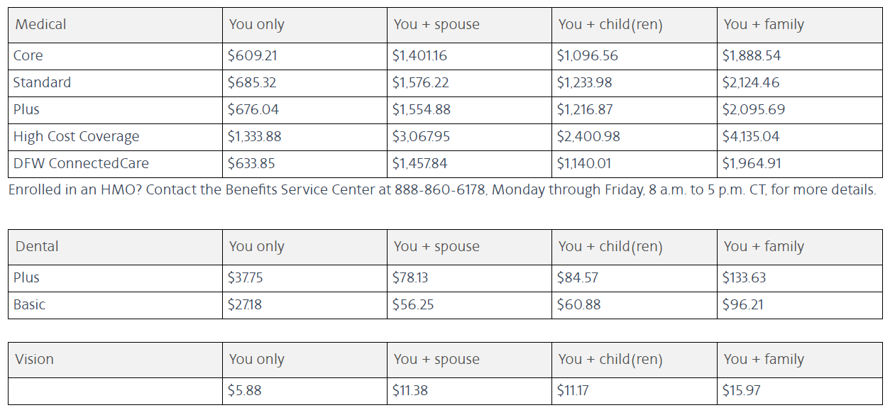
2022 Cobra Rates
The terms of the plan, program or Company policy documents govern the benefits and privileges highlighted in this presentation. If there is a conflict between this presentation and the plan program or Company policy document will govern the actual benefit or privilege.

Slide 17
Life Insurance & Accidental Death
& Dismemberment (AD&D)
Life Insurance
You may convert your employee term life insurance coverage to an individual policy with MetLife within 60 days of retirement
Contact MetLife directly with inquiries
1-877-275-6387 www.metlife.com/mybenefits
AD&D
You may convert your accident insurance to an individual policy by contacting New York Life directly within 60 days of retirement
Contact New York Life directly with inquiries 1-800-238-2125
The terms of the plan, program or Company policy documents govern the benefits and privileges highlighted in this presentation. If there is a conflict between this presentation and the plan program or Company policy document will govern the actual benefit or privilege.

Slide 18
Added Benefits
You may convert your added benefits
Auto and Home
Legal Plan
Identity Theft Program
Pet Insurance
Long-Term Care Insurance
Critical Illness
Accident Insurance
Contact Added Benefits directly with inquiries
1-855-550-0706 AAaddedbenefits.com
The terms of the plan, program or Company policy documents govern the benefits and privileges highlighted in this presentation. If there is a conflict between this presentation and the plan program or Company policy document will govern the actual benefit or privilege.

Slide 19
Retiree Travel Privileges
Personal Travel Boarding Priority; Accommodated in this order | Eligible Travelers | Annual One-Way (OW) Pass Allotment
D1 | Retirees, spouse, or Domestic Partner (DP), or Registered Companion (RC), qualified children up to age 24. | 6 per eligible person
D2R | Retirees, former employees with travel privileges, spouse, DP, or RC, qualified children up to age 24. | Unlimited, unless otherwise documented
D2P | Qualified Parents/In-Laws, former employees with travel privileges, and retirees. | Unlimited, unless otherwise documented.
D3 | Extended family members, friends and personal acquaintances, provided they are eligible for travel. | 8 per Retiree to be shared among Guest Travelers
You also receive AA20 discounts, OAL travel on other airline travel and A9 emergency passes
Please access the retiree site to view all details about retiree travel privileges
The terms of the plan, program or Company policy documents govern the benefits and privileges highlighted in this presentation. If there is a conflict between this presentation and the plan program or Company policy document will govern the actual benefit or privilege.

Slide 20
TWU/IAM - Sick time applied to RHRA
Election must be made 4 months in advance of retirement date
Online election can be found on Step 1 of the Retirement Planning Checklist on Jetnet. If no election, defaulted to sick leave payout
Multiply your number of unused sick hours in your sick leave bank as of the date of retirement by 50% of your hourly rate at retirement
Your RHRA is available to use until your funds are depleted
Account information will be on the Benefits Service Center site
The terms of the plan, program or Company policy documents govern the benefits and privileges highlighted in this presentation. If there is a conflict between this presentation and the plan program or Company policy document will govern the actual benefit or privilege.

Slide 21
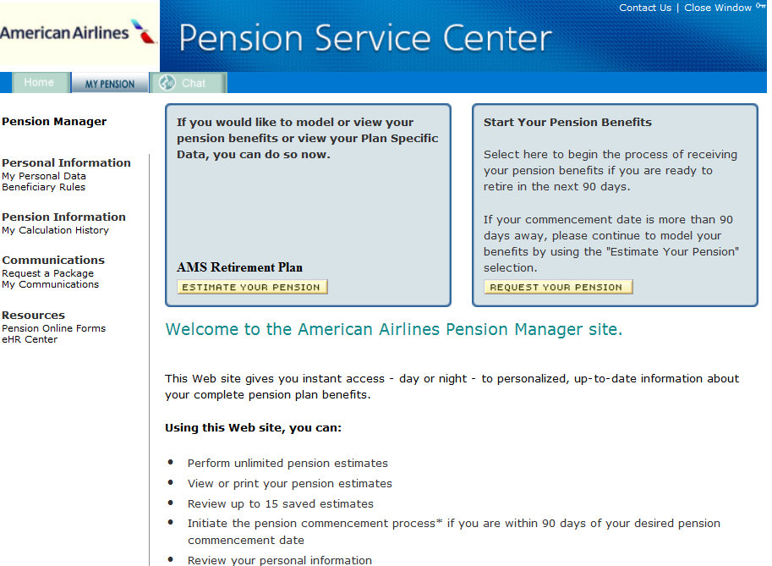
Pension Estimate & Pension Forms
1
Go to the Pension Service Center
Click “Run an Estimate” or “Request your Pension”
2
You are REQUIRED to request a kit by the 15th of the month prior to your commencement date
Follow the instructions on the screen to run an estimate or to request a pension package
If you have questions, call or chat live online with an HR Services representative or 1-866-470-0847
The terms of the plan, program or Company policy documents govern the benefits and privileges highlighted in this presentation. If there is a conflict between this presentation and the plan program or Company policy document will govern the actual benefit or privilege.

Slide 22
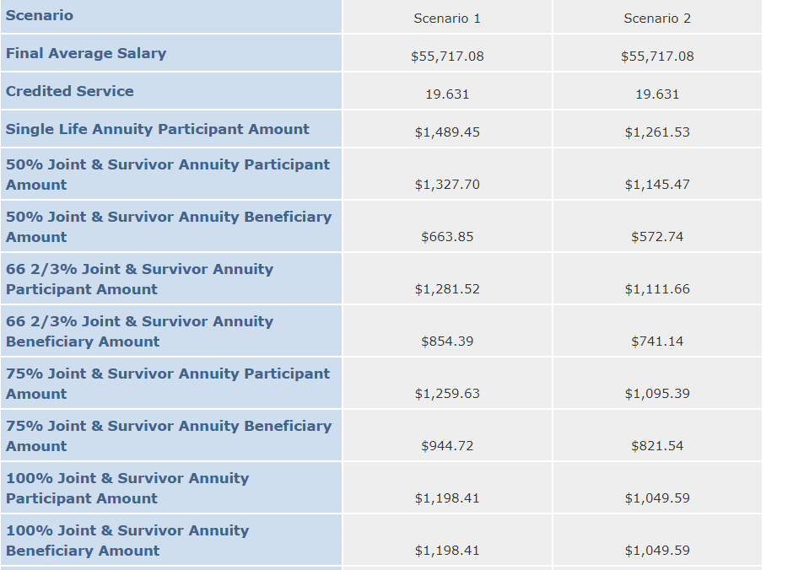
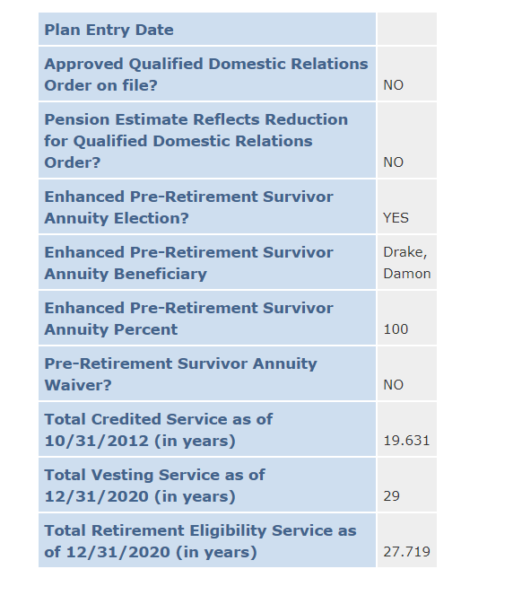
Pension Estimates & Details
You can run different scenarios and then compare side by side results (ex age 55 and age 60)
View your Plan Specific Details
The terms of the plan, program or Company policy documents govern the benefits and privileges highlighted in this presentation. If there is a conflict between this presentation and the plan program or Company policy document will govern the actual benefit or privilege.

Slide 23
Defined Benefit Pension Plans
PBGC (TWA or Legacy US Airways)
www.pbgc.gov
mypension@pbgc.gov
(800)400-7242
IAM Pension Fund
http://iamnpf.org
contact@iampf.org
(800)424-9608
The terms of the plan, program or Company policy documents govern the benefits and privileges highlighted in this presentation. If there is a conflict between this presentation and the plan program or Company policy document will govern the actual benefit or privilege.

Slide 24
Pension Benefit Payment Options
Single Life Annuity
This option pays a monthly benefit from your benefit commencement date until your death
Joint & Survivor Annuity Options
These options pay a reduced benefit for your lifetime with 50%, 66 2/3%,75% or 100% of the amount you were receiving payable for your Joint Annuitant’s remaining lifetime after your death.
If your joint annuitant dies before you, your benefit continues for your lifetime and no benefit is payable after your death
The terms of the plan, program or Company policy documents govern the benefits and privileges highlighted in this presentation. If there is a conflict between this presentation and the plan program or Company policy document will govern the actual benefit or privilege.

Slide 25
Payment Options cont.
Guaranteed Period Options
This option pays a reduced lifetime monthly benefit to you with a guaranteed number of payments—120, 180, or 240 months—depending on the option you elect
If you die before all guaranteed payments are made, the remaining guaranteed payments are made to your beneficiary
If you live longer than the number of guaranteed payments, you continue to receive monthly payments until your death and no further benefit is payable to your beneficiary after your death
If your beneficiary dies before you, you may designate a new beneficiary
If your beneficiary dies after you, but before all guaranteed payments are made, your beneficiary’s beneficiary will receive the balance of guaranteed payments either as a monthly benefit or as a lump sum, if elected
The terms of the plan, program or Company policy documents govern the benefits and privileges highlighted in this presentation. If there is a conflict between this presentation and the plan program or Company policy document will govern the actual benefit or privilege.

Slide 26
Payment Options cont.
Level Income Annuity Option
This option is designed to provide a level income during retirement by taking into account your Social Security benefit
The Level Income Annuity Option provides an increased monthly benefit to age 62 or Social Security Normal Retirement Age, as selected by you, when many people begin receiving Social Security benefits
The monthly benefit decreases when you reach the selected age (62 or Social Security Normal Retirement Age) even if you do not begin receiving Social Security benefits at that age
This option is always combined with another option such as a Single Life Annuity, a Joint & Survivor Annuity, or a Guaranteed Period Option
Monthly benefit decreases when you reach the selected age, even if you do not begin collecting Social Security benefits at that time
The terms of the plan, program or Company policy documents govern the benefits and privileges highlighted in this presentation. If there is a conflict between this presentation and the plan program or Company policy document will govern the actual benefit or privilege.

Slide 27
Contacts
The terms of the plan, program or Company policy documents govern the benefits and privileges highlighted in this presentation. If there is a conflict between this presentation and the plan program or Company policy document will govern the actual benefit or privilege.

Slide 28
Contacts
Benefits Service Center 888-860-6178
Team Member Services EmployeeServices@aa.com
People Business Partners People.Support@aa.com
Payroll PSC@aa.com
AA Retirement Services Retirement.Services@aa.com
HR Services (LAA Pension) 866-470-0847
Fidelity Investments 800-354-3412 or www.netbenefits.com/aa
The terms of the plan, program or Company policy documents govern the benefits and privileges highlighted in this presentation. If there is a conflict between this presentation and the plan program or Company policy document will govern the actual benefit or privilege.

Slide 29
Questions

