Slide 1
TWU Semi-Annual Meeting
Benefits and Well-Being
June 14, 2022
Privileged & Confidential

Slide 2
Agenda
Topic | Presenter
EAP | Kevin Reese
LTD Plan Performance | Julie Hanna
my.aa.com | Stephanie Armstrong
New Hires – Enrollment Process | Julie Hanna

Slide 3
Employee Assistance Program
(EAP)

Slide 4
EAP
Union/Workgroup | Utilization
APA | 153
APFA | 1,156
CWA-IBT | 846
IAM | 678
TWU | 405
PAFCA | 15
Management & Support Staff | 906
14.3%
utilization rate
3,592
Member services provided
57% higher than Aetna’s book of business
Top 5 Issues
Anxiety 13%
Relationships 12%
Depression 10%
Stress 10%
Grief/Loss 6%

Slide 5
EAP
24/7 support for team members and all members of their household
EAP can help support all of life’s moments
Mental health
Substance abuse
Work-life balance
Improving relationships
Childcare and elder care resources
Financial resources
Transportation and housing needs
Education assistance
And more!
Four free sessions per issue per year for each member of your household with an onsite EAP or local provider
Onsite EAP counselors available at all AA hubs
CLT LAX PHL
DFW MIA PHX
JFK ORD TUL
Find more information on my.aa.com/eap or call 833-721-2322

Slide 6
IAM/TWU
Long Term Disability (LTD)

Slide 7
IAM/TWU LTD Plan data
Incidence & Activity | 2021 | 2022
Average covered lives | 16,959 | 14,039
Approved claims | 37 | 17
Incidence rate per 1,000 lives | 2.2 | 3.6^
Claim receipts | 163 | 79
LTD Highlights 2021-2022
54 approved claims from 2021 & 2022 Average age at disability of 50.2 years Length of service 17.8 years 78% male 20% from TX, 17% from NC, 13% from IL 29 of 54 approvals are TWU, 25 IAM 36% of denials were for those with no coverage, 27% were abandoned claims, 15% were due to elimination period not satisfied Average duration of 7.3 months of disability
^annualized, based on data from first 4 months of 2022 year
Decisional metrics based on the year decision was made

Slide 8
my.aa.com

Slide 9
Help for new hires
We’ve redesigned the new hire page of my.aa.com to provide more information to team members in a centralized location

Slide 10
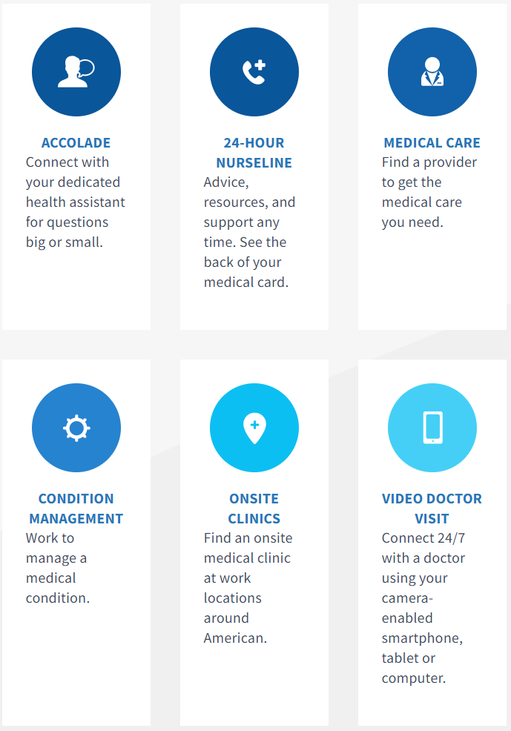
my.aa.com
Workgroup-specific printable guides are available for team members who need an at-a-glance guide to American’s benefits
my.aa.com is your primary resource for benefits information
Learn about options that you have as a new hire
Get more information on plan options and where to go for additional assistance.
Plan guides, both current and historical, are available
Contact guide to connect you with any benefits vendor
Direct links to the Benefits Service Center and Accolade through single sign on

Slide 11
New Hire Enrollment

Slide 12
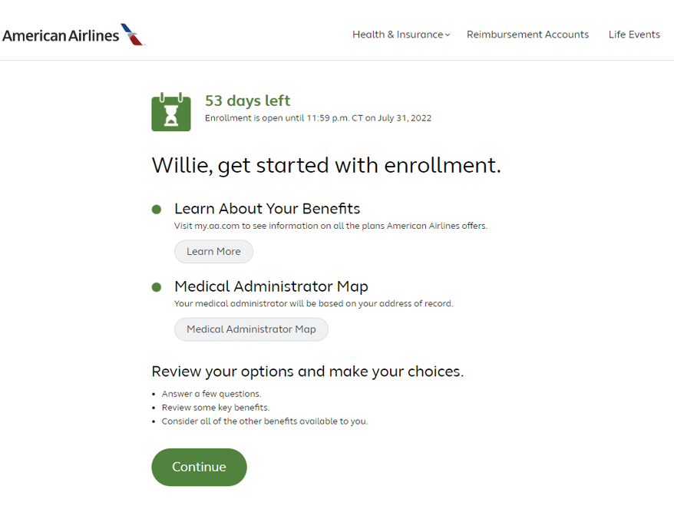
Refreshed enrollment experience
We’ve overhauled our new hire enrollment experience to provide new team members with more information so they can make the best choices for themselves and their families.

Slide 13
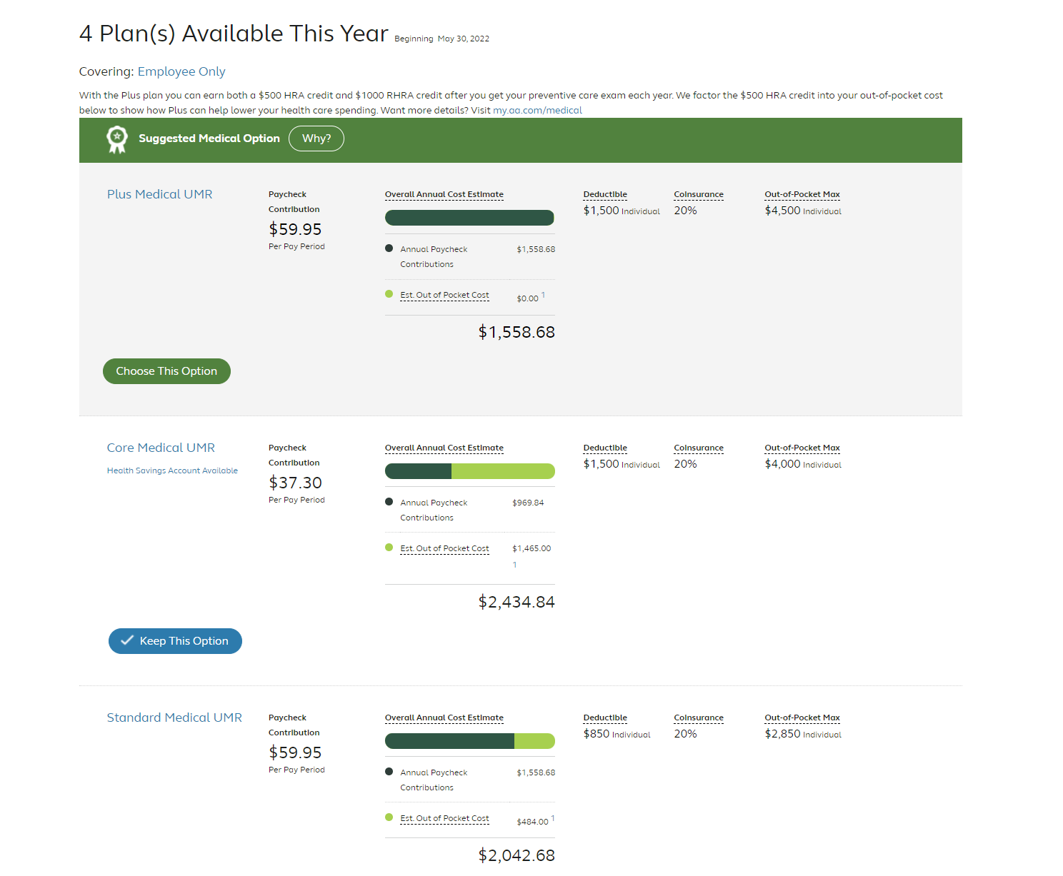

Slide 14
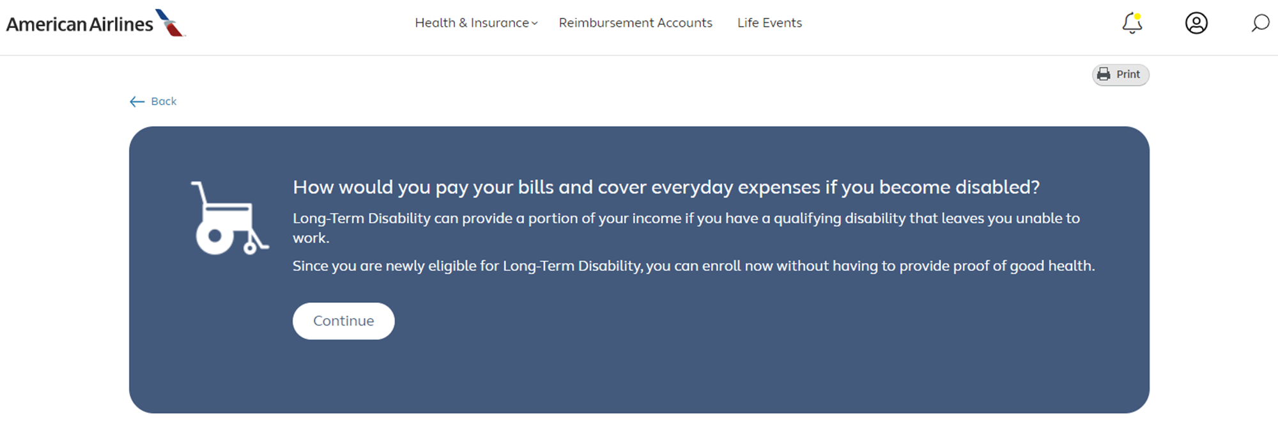

Slide 15
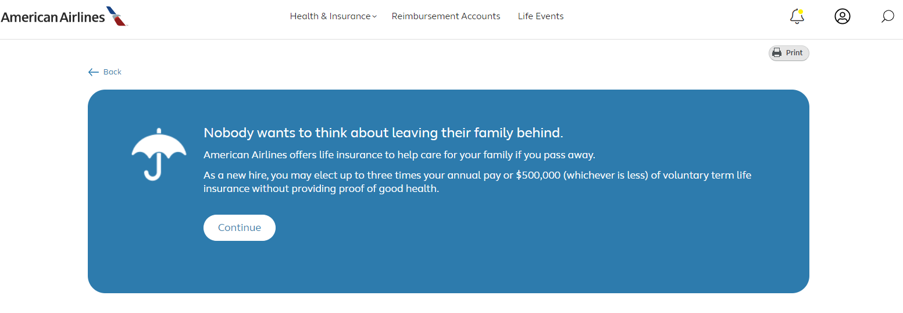

Slide 16
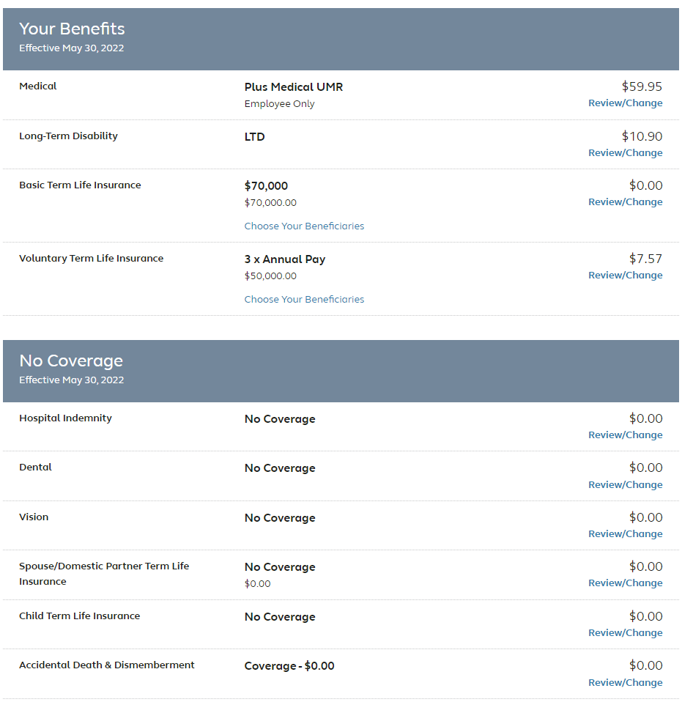

Slide 17
Questions?

